Slide 1
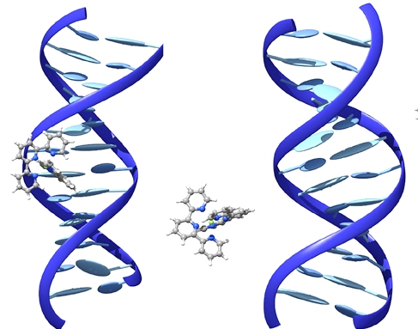
Symposium on Chemical Biology And Drug Discovery
(SCBDD-2017)
&
4th Annual Meeting of Chemical Biology Society (CBS), India
October 30-31, 2017 at Bose Institute, Kolkata
A major challenge facing chemical biologists is the ability to effectively identify and manipulate the molecular components of diverse biological systems. The “SCBDD-2017” presents a unique platform to discuss Chemical Biology and Drug Development Research among scientific communities. The aim of “SCBDD-2017” is to bring together scientists from across disciplines to explore new approaches and methods in molecular level understanding of biological systems and development of drugs. This symposium will explore how effectively chemists and biologists are using the tools and philosophy of chemical biology to understand the molecular basis of diseases.
Patrons:
Prof. S. Chattopadhyay
Director, CSIR-IICB, Kolkata
Prof. V. Ravichandiran
Director, National Institute of
Pharmaceutical Education and Research
(NIPER), Kolkata
Prof. S. K. Datta
Vice-Chancellor (acting),
Visva-Bharati, Santiniketan
Prof. K. S. Rangappa
Former Vice-Chancellor,
University of Mysore
Organizing Committee:
President
Prof. Siddhartha Roy
President, CBS and Director (Officiating),
Bose Institute, Kolkata
Vice Presidents
Prof. V. Nagaraja
President, JNCASR, Bangalore
Prof. K. N. Ganesh
Director, IISER-Pune
Prof. S. Bhattacharya
Director, IACS, Kolkata
Prof S. Verma
Professor, IIT-Kanpur
Prof. Tapas Kumar Kundu
Secretary, CBS & Professor JNCASR
Convener
Prof. A. Banerjee, IACS, Kolkata
Joint Convener
Prof. S. S. Roy, CSIR-IICB, Kolkata
Joint Treasurers
Prof. G. Suresh Kumar
CSIR-IICB, Kolkata
Prof. P. Jaisankar, CSIR-IICB, Kolkata
Members
Prof. A. Chaudhuri, CSIR-IICT,
Hyderabad
Prof. G. Basu, Bose Institute, Kolkata
Prof. P. K. Das, IACS, Kolkata
Dr. S. Ghosh, CSIR-IICB, Kolkata
Dr. R. Kundu, Visva Bharati,
Santiniketan
Prof. P. Sarkar, Visva Bharati,
Santiniketan
Prof. P. Chowdhury, Visva Bharati,
Santiniketan
The two days symposium will address on the following themes:
Chemical Biology & Epigenetic Diseases
Metabolism & Disease
Understanding of Complex Gene Expression Network
Chemical Biology Approach to Elucidate Process of Differentiation
Chemical Biology & Natural Products
The Interdisciplinary Approaches in Chemical Biology
Cross-talk between synthetic Biology and Chemical Biology
Nanotechnology & Chemical Biology
Understanding of Dynamic Genome Organisation
Target Approach to Rare Diseases
Drug Development & Medicinal Chemistry
Pharmaceutical Formulations
Molecular Drug Design
Novel Drug Delivery
Tentative Speakers
Prof. T. K. Chakraborty (IISC., Bangalore)
Prof. S. Bhattacharya (IACS, Kolkata)
Prof. S. Chattopadhyay (IICB, Kolkata)
Prof. A. Chaudhuri (IICT, Hyderabad)
Prof. S. Bhattacharya (Visva Bharati, Shantiniketan)
Prof. G. Basu (Bose Institute, Kolkata)
Prof. A. K. Nandi (IACS, Kolkata)
Prof. A. Dinda (AIIMS, New Delhi)
Prof. G. Suresh Kumar (CSIR-
IICB, Kolkata)
Prof. G. Kundu (NCCS, Pune)
Prof. T. Govindaraju (JNCASR, Bangalore)
Dr. R. Sinha Roy (IISER, Kolkata)
Prof. R. Majithaya (JNCASR, Bangalore)
Prof. M. Eswaramoorthy (JNCASR, Bangalore)
Prof. B. J. Rao (TIFR, Mumbai)
Prof. R. Banerjee (IICT, Hyderabad)
Dr. S. Sivakumar (IIT, Kanpur)
Dr. J. Dash ( IACS, Kolkata)
For further information please contact:
Prof. A. Banerjee, Convener, SCBDD-2017
Senior Professor, Department of Biological Chemistry, Indian Association for the Cultivation of Science, 2A & 2B Raja S. C. Mullick Road, Jadavpur, Kolkata-700032, India. Tel: 033-2473-4971 (Ext 1504) Fax: 033-2473-2805.
Email: chemicalbiologysociety@gmail.com;
Website: www.cbs-india.org
Registration Fee:
Students: Rs. 3000/-
Faculties: Rs. 3500/- (members)
Rs. 4500/- (non-members)
Last Date for abstact submission:
9th October, 2017
Organized by
Chemical Biology Society (CBS), India

